Slide 1

Introduction to Computer Science: Programming Methodology
Tutorial 3
PYTHON BASICS
Chulin Dai
122090066@link.cuhk.edu.cn

Slide 2
Outline
1. Data types, e.g. integer, string, boolean etc.
2. print() function.
3. Some arithmetic operators, e.g. +, -, *, /, //, %, ** etc.
4. input() function.
5. eval() function.

Slide 3
1.Data Types
There are several data types very often used: i)Integer, e.g. 1,19,-36… ii)Floating-point number, e.g. 3.14159, 9.80… iii)String, e.g. ‘hello world’, ‘123’, ‘www.cuhk.edu.cn’… iv)Boolean, the value can only be True or False, e.g. 5>9, ‘b’<‘a’,1==‘1’… v)List, e.g. [1,2,3], [‘h’, ‘e’, ‘l’, ‘l’, ‘o’]…
Assign some value of different types to a variable will make it become different data types.
Using type() function you can check the data type of a variable.
Data types can be forced to change if possible, e.g. int(9.8)->9, str(123)->’123’, float(‘9.8’)->9.8, list(‘hello’)-> [‘h’, ‘e’, ‘l’, ‘l’, ‘o’] …

Slide 4
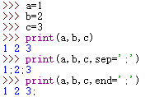
2.print() Function-I
print() is a function-something you can realize some functionalities by calling it.
The “()” is for you to put in some variables as input.
You can use help(print) in shell to check how it is used.
The parameters usually used in print() function is print(value, sep, end).
“value” is the content you want to print out, e.g. print(“hello”), print(1,2,3) etc.
“sep” is the symbol you use to separate many values, by default it is ‘ ’ if without mentioned. But you can change it to ‘,’, ‘-’or ‘*’ ... e.g. print(1,2,3,sep=‘,’).
“end” is the symbol you use to end you output, by default it is ‘\n’if not being mentioned. You can change it to ‘ ’, ‘;’ or ‘end’… e.g. print(‘hello’, end=‘#’).

Slide 5
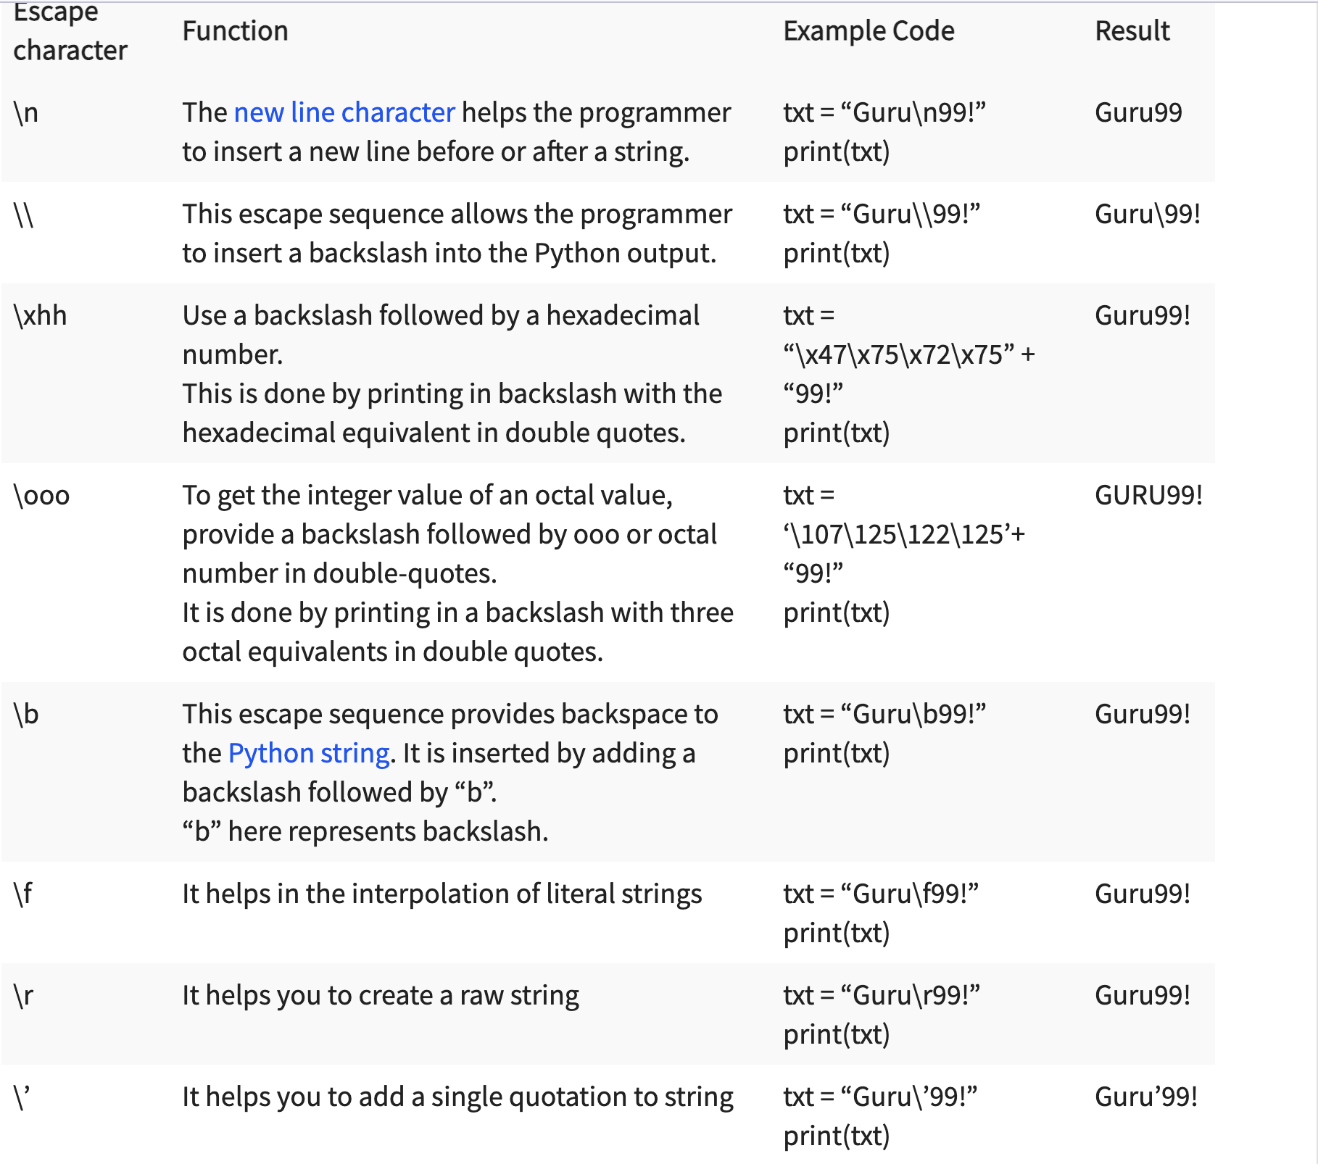
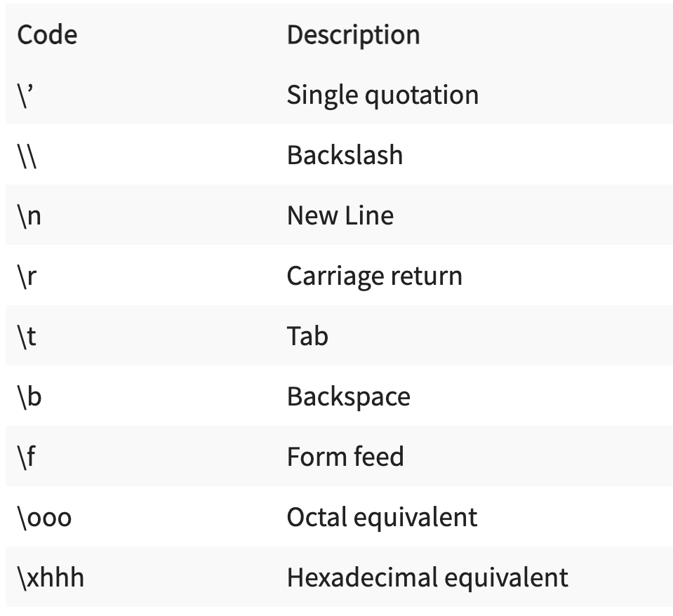
2.print() Function-I
Escape Character

Slide 6



2.print() Function II-Formatted Output-A
“d” in print(‘%d’%v) means the variable v is integer type; “f” in print(‘%f’%v) means the variable v is a floating point number; “s” in print(‘%s’%v) means the variable v is a string.
Determine the space for the variable to be shown: the number(‘8’) before ‘d’ in print(‘%8d’%v) means 8 spaces for the integer v; the number(‘7.2’) before ‘f’ in print(‘%7.2f’%v) means 7 spaces for the floating point number v while keeping the 2 digits after decimal point ‘.’.
To align the result leftward, add the symbol ‘-’: print(‘%-8d’%v) will make the integer v printed from the left of the 8 spaces. Without ‘-’ will align the result rightward.

Slide 7
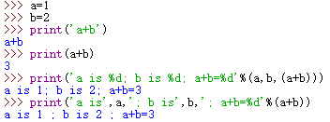
2.print() Function III-Formatted Output-B
To print many values within some predefined formats: print(‘%s has %d petals and is worth %.2f yuan a bunch.’%(FlowerName, NumOfPetal, Price )) where the variable ‘FlowerName’ is the name of a flower(string type), ‘NumOfPetal’ is the number of petals of the flower(integer type), ‘Price’ is the price of the flower (floating point number).

Slide 8
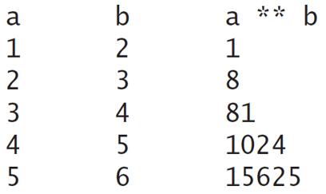
Practice 1:Print a table
Write a program that displace the following table(8 spaces for each numbers and they are aligned leftward):

Slide 9
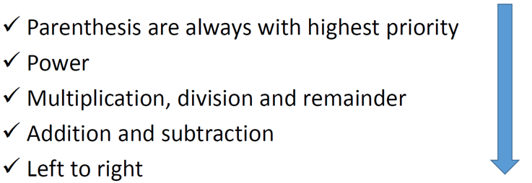
3.Arithmetic Operators
Some arithmetic operators often used: Addition +, Subtraction -, Multiplication *, Division /, Modulus(Remainder) %, Exponent(Power) **, Floor division // etc.
Order of operations(Operator precedence):
Augmented assignment operators: “x+=1” means “x=x+1”, “x//=10” means “x=x//10”, similar for “x-=1”, “x%=10”, “x**=2”,…

Slide 10
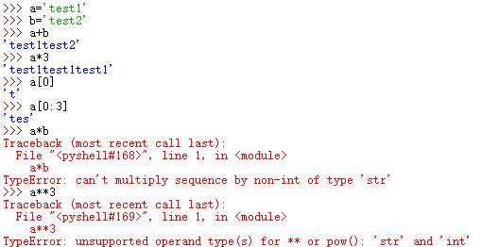
3.Arithmetic Operators
Some operators for string type variables: +: Concatenation - Adds values on either side of the operator *: Repetition - Creates new strings, concatenating multiple copies of the same string [ ]: Slice - Gives the character from the given index [ : ]: Range Slice - Gives the characters from the given range

Slide 11

4.input() Function
input() is a function used for instructing the users to input a string for a variable. Notice that the data type that input() function return is a string, that is, if you assign the result to a variable e.g. v=input(), then v is a string data type.
You can use a string as a variable for the input() function as an instruction, e.g. input(“Please input a number:”)

Slide 12
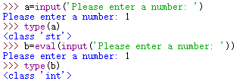
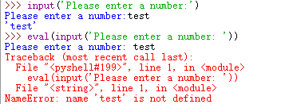
5.eval() Function
eval() is a function used to parse and evaluate the Python expression(a string) you put as a variable for the eval() function, i.e. as if the ‘’ of the expression is taken away.
eval() is often used together with input() in order to change the string, which is returned by input() function, into the data type you want, e.g. N=eval(input()) will make the value passed to variable N be an integer, a floating-point number or a boolean if you input 9, 3.14 or 3>5 respectively, for instance.

Slide 13
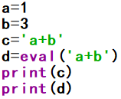
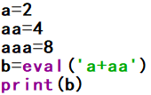
5.eval() Function
Example: what are the outputs of the following cases?
i)
ii)

Slide 14
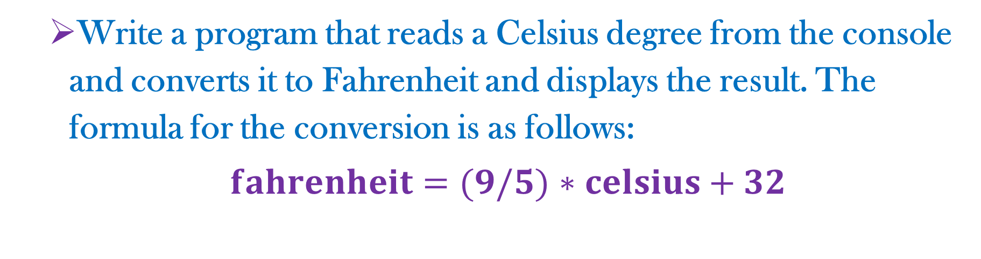
Practice 2:Convert Celsius to Fahrenheit
Write a program that reads a Celsius degree from the console and converts it to Fahrenheit and displays the result. The formula for the conversion is as follows:
$fahrenheit=(9/5)$ $∗celsius+32$
Here is a sample:

Slide 15

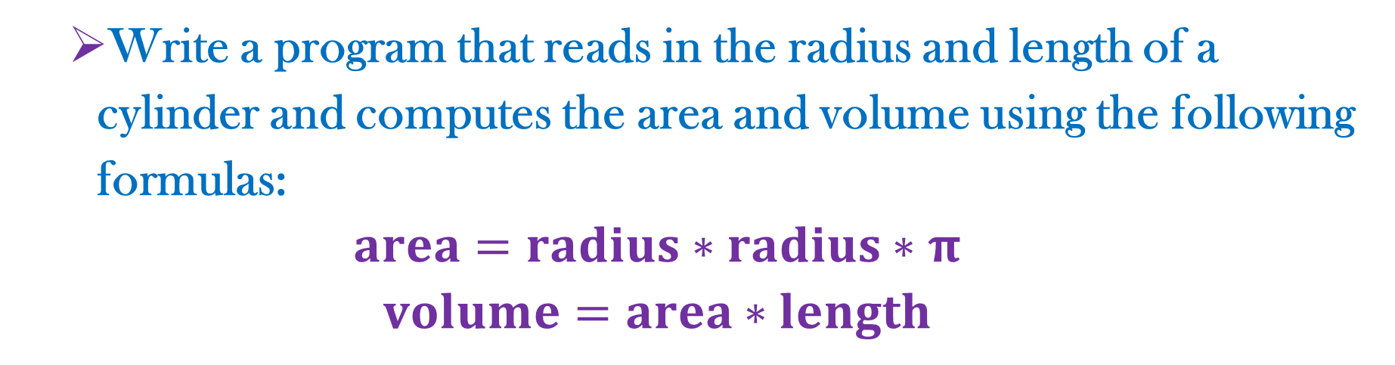
Practice 3:Compute the volume
Write a program that reads in the radius and length of a cylinder and computes the area and volume using the following formulas:
$$area=radius∗radius∗π$$
$$volume=area∗length$$
Here is a sample:

Slide 16

Practice 4: Sum the digits
Write a program that reads an integer between 0 and 1000 and adds all the digits in the integer. For example, if an integer is 932, the sum of all its digits is 14. (Hint: Use the % operator to extract digits, and use the // operator to remove the extracted digit. For instance, 932%10=2 and 932//10=93.)
Here is a sample:

Slide 17
Practice 5: Number of years and days
Write a program that prompts the user to enter the minutes (e.g., 1 billion), and displays the number of years and days for the minutes. For simplicity, assume a year has 365 days.
Here is a sample:

Slide 18
Practice 6: Financial application: compound value
Suppose you save $100 each month into a saving account with monthly interest rate 0.417%. That is, i)after the first month, the value in the account becomes 100*(1+0.00417)=100.417; ii) after the second month, the value in the account becomes (100+100.417)*(1+0.00417) =201.252; iii)after the third month, the value in the account becomes (100+ 201.252)*(1+0.00417)=302.507; and so on. Write a program that prompts the user to enter a monthly saving amount and displays the account value after the sixth month.
Here is a sample:

